Slide 1
RENEWABLE RESOURCES
Subtitle

Slide 2
INTRODUCTION
Renewable energy refers to energy that is generated from natural resources that are replenished constantly, such as sunlight, wind, rain, tides, waves, and geothermal heat.
Unlike fossil fuels, which are finite and contribute to environmental pollution and climate change when burned, renewable energy sources offer a cleaner and more sustainable alternative.

Slide 3
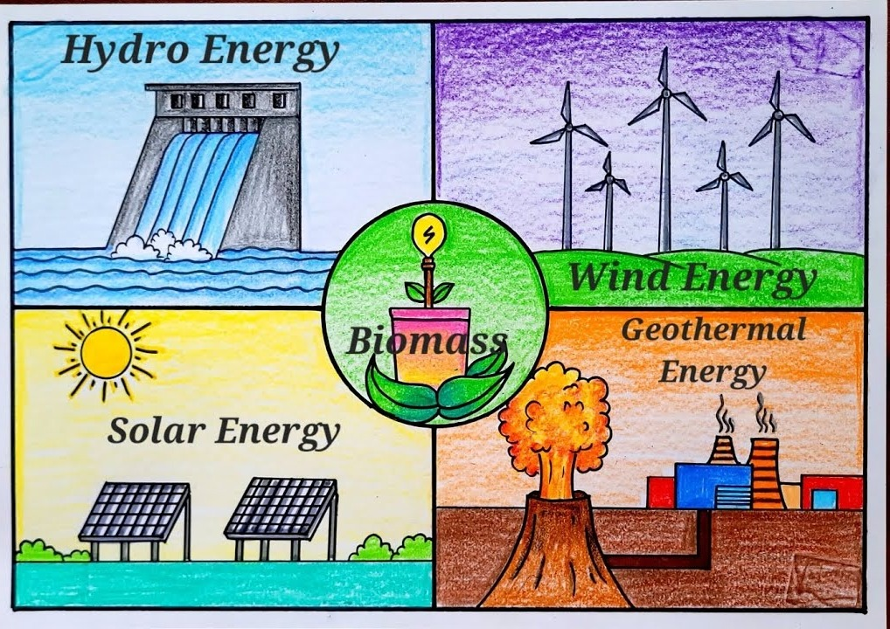
Forms of Renewable Energy
Biogas Energy
Hydro Energy
Solar Energy
Wind Energy
GeoThermal Energy

Slide 4
RENEWABLE RESOURCE DATASET
Renewable energy datasets provide valuable information for analyzing trends and patterns in clean energy production.
Python is a powerful programming language widely used for data analysis, data visualization and data manipulation due to its simplicity and versatility.
Monitoring renewable energy trends through datasets enables stakeholders to identify areas for improvement and innovation in the sector

Slide 5
Python libraries such as Pandas and NumPy can be used to handle missing values, standardize data formats, and perform data transformations.
NUMPY
NumPy is a fundamental Python library for numerical computing.
It provides support for large, multi-dimensional arrays and matrices, along with a collection of mathematical functions to operate on these arrays efficiently.
It's widely used in various fields such as physics, chemistry, biology, engineering, finance, and machine learning.

Slide 6
some key aspects of the NumPy library:
Array Operations:
Slicing,logical, shape manipulation, sorting, selecting, and I/O operations.
Broadcasting:
Allows NumPy to work with arrays of different shapes when performing arithmetic operations
Random Number Generation:
NumPy provides functions to generate random numbers and random distributions efficiently.
Linear Algebra:
NumPy has a rich set of functions for linear algebra operations, including matrix multiplication, decomposition.

Slide 7
PANDAS
Pandas is a powerful Python library widely used for data manipulation and analysis.
Some key features of the Pandas library include:
DataFrame: The primary data structure in Pandas is the DataFrame, which is a two-dimensional labeled data structure with columns rows.
Series: A Series is a one-dimensional labeled array.
Data Manipulation: Pandas provides a wide range of functions for data manipulation, including merging, joining, reshaping, slicing, indexing, grouping, and aggregating data.
Data cleaning:isnull(),notnull(),fillna(),dropna()
--> isnull(): It used to detect missing or null values in a Dataframe or Series
--> notnull():It's used to check for non-null values in a DataFrame or Series

Slide 8
-->dropna():function in Pandas is used to remove rows or columns from a DataFrame that contain missing values (NaN).
-->fillna(): it is used to fill missing (NAN) values with specified values
Describe(): It is used to generate descriptive statistics of a dataframe or series .It provides summary such as count,mean,standard deviation,minimum,maximum.

Slide 9
.
MATPLOTLIB
Matplotlib is a popular Python library used for creating static, interactive, and animated visualizations.
Matplotlib's key features and functionalities:
Multiple Plotting Styles:It supports multiple plotting styles ,including pyplot module and object -oriented ploting with the “figure” and “axes” objects.
Wide Range of Plot Types: Matplotlib supports a wide range of plot types, including line plots, scatter plots, bar plots, histogram plots, pie charts, 3D plots,bubble-plot.
Customization: Users can customize every aspect of their plots, including colors, line styles, markers, labels, axes, grids, legends, and annotations.

Slide 10
CONCLUSION
Renewable resources are the cornerstone of a sustainable energy future, offering abundant, clean power while mitigating climate change. By harnessing nature's gifts like solar, wind, hydro, and geothermal energy, we ensure a reliable and resilient energy supply for generations. Moreover, investing in renewables fosters economic growth, job creation, and technological innovation, while enhancing energy security and reducing reliance on imported fuels. As we continue to embrace renewables, we pave the way for a brighter, greener future where energy is clean, accessible, and equitable for all.

